Slide 1
Enterprises use a combination
Organize Subscriptions via Management Groups
Microsoft Defender for Cloud – Just in Time Access (JIT)
a. Recommendations
b. Workflow Automation enable JIT on VM automatically
Custom Azure Policies
a. Audit - Compliance
Append – at time of deployment
Deny – prevent deployment
Deploy if Not Exists (DINE) – remediate existing deployments
Network Security Workbook – Policy Compliance – Secure Score

Slide 2
Let look at the older approach and then what is now available: Azure Virtual Network Manager (AVNM)
Model 1 - Central governance
In this model, NSGs are managed by a central governance team within an organization.
Pros | Cons
The central governance team can enforce important security rules. | Operational overhead is high as admins need to manage each NSG, as the number of NSGs increases, the burden increases.

Slide 3
Model 2 - NSGs are managed by individual teams.
In this model, NSGs are managed by individual teams within an organization without a centralized governance team.
Pros | Cons
The individual team has flexible control in tailoring security rules based on their service requirements. | The central governance team can't enforce critical security rules, such as blocking risky ports. Individual team might also misconfigure or forget to attach NSGs, leading to vulnerability exposures.

Slide 4
Model 3 - NSGs are created through Azure Policy and managed by individual teams.
In this model, NSGs are still managed by individual teams. The difference is the NSGs are created using Azure Policy to set standard rules. Modifying these rules would trigger audit notifications.
Pros | Cons
The individual team has flexible control in tailoring security rules. The central governance team can create standard security rules and receive notifications if rules are modified. | The central governance team still can't enforce the standard security rules, since NSG owners in teams can still modify them. Notifications would also be overwhelming to manage

Slide 5
Enterprises roll out slowly
Start testing Just in Time Access (JIT) in Azure Subscriptions
Start testing Policy on a Resource Groups and then Subscriptions
Recommendations – trigger notifications to Azure Owners – via emails (Workflow automation)
Is Governance Risk and Compliance (GRC) using Secure Score and Control ‘Secure management ports’
Root Management group
Management group
Subscription
Resource group
Resource (NSG)

Slide 6
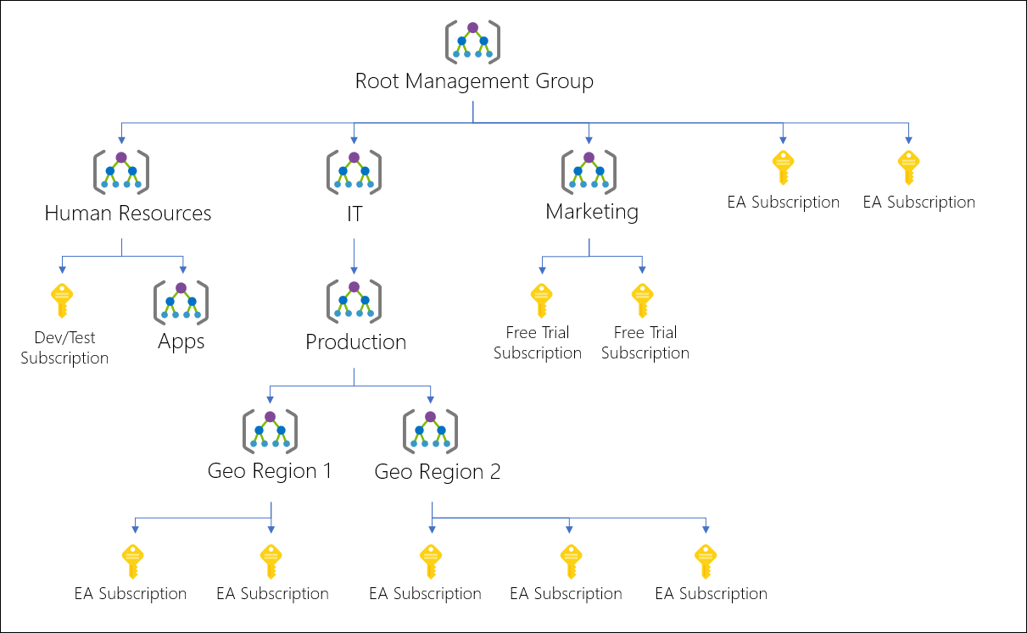
Azure Management Group

Slide 7
Personas – Landing Zones – An Example
landing zone 1 - no vpn to company, no public access
landing zone 2 - sensitive information or VPN back to company, << Need to understand R&D - VMs --> (300 developers) <- Azure Defender for Servers, Azure Defender for PaaS | MDE installed – Windows – Linux.
landing zone 3 - Corp IT, Hosted Customers Environments. VDC, tanium (updates), existing tools, amp (av), Prisma (posture mgmt) \ PaaS Stuff <- Azure Defender for PaaS

Slide 8
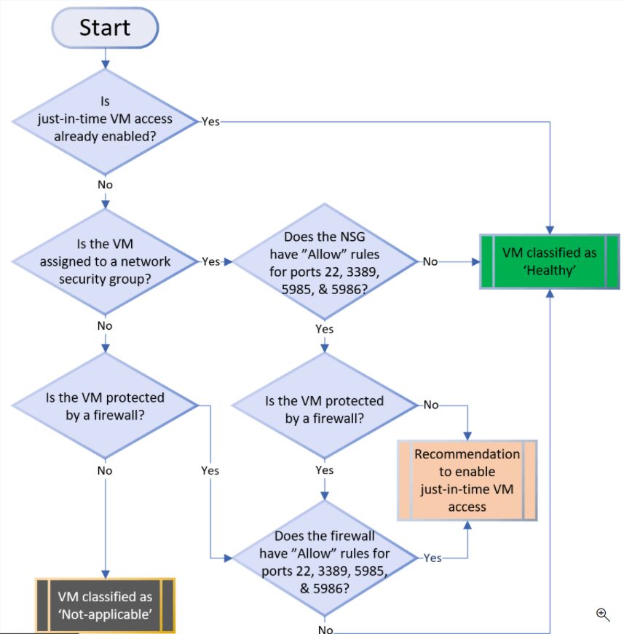
Defender for Cloud – Just in Time Access (JIT)
Microsoft Defender for Servers is turned on in Azure Subscription or MG
Workflow Automation – New VM – receives JIT
Azure Policy to auto deploy Workflow Automation across Subs in MG.
Assigned via REST API

Slide 9
Custom Azure Policy based on needs
Audit (continual operation)
Deny (greenfield)
Append (greenfield)
Deploy if Not Exists (DINE) (brownfield)
Root Management group
Management group
Subscription
Resource group
Resource (NSG)

Slide 10
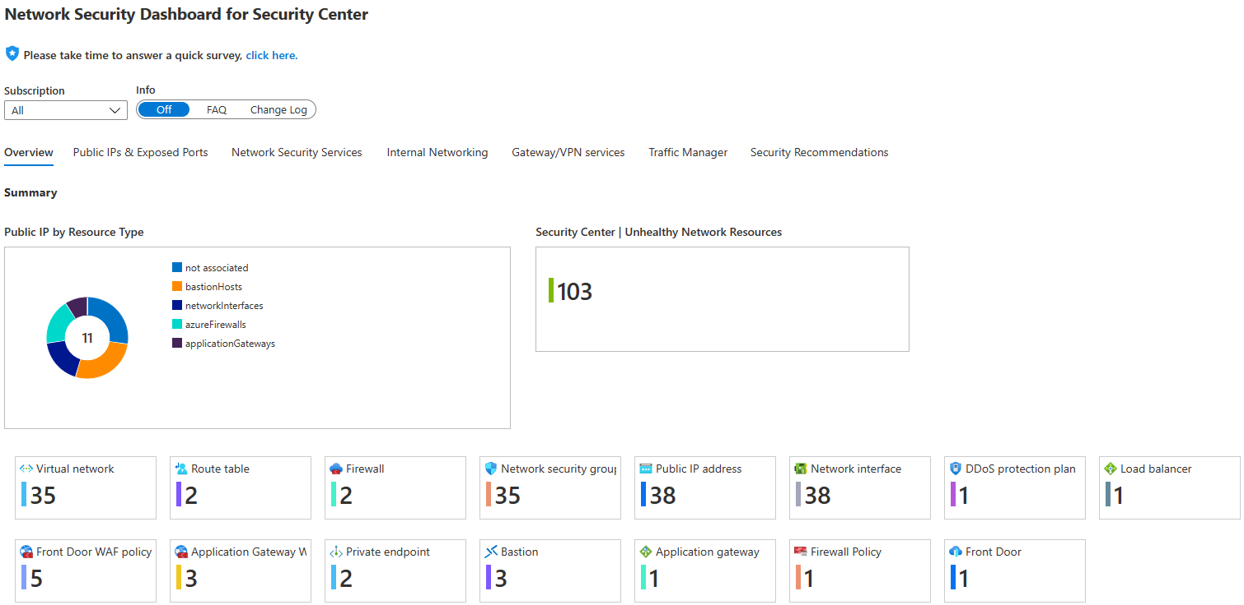
Network Security Dashboard

Slide 11
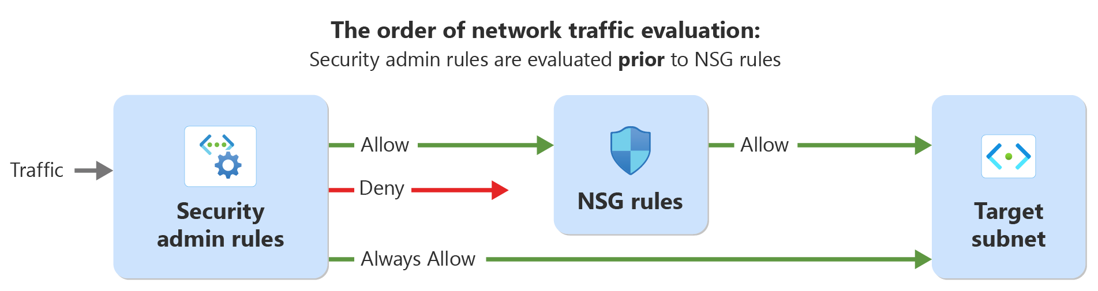
Introducing Azure Virtual Network Manager (AVNM) – Security Admins

Slide 12
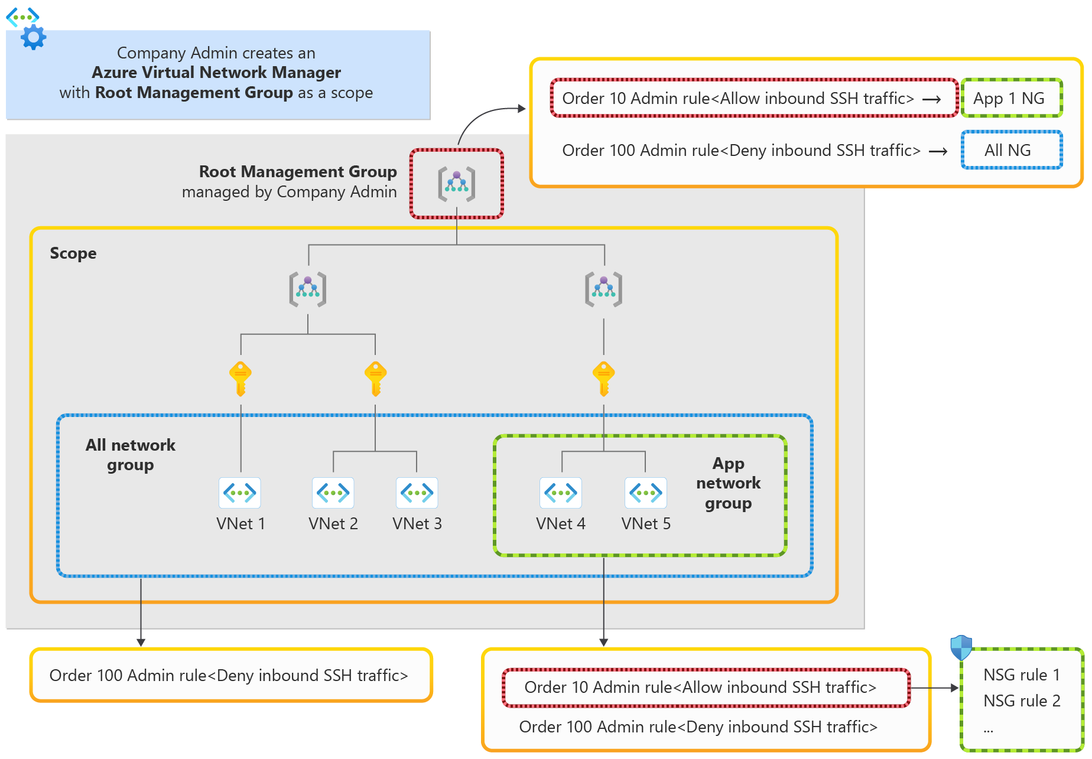
Enforcement and flexibility in practice

Slide 13
Deployment Steps
Create a network manager instance
create a network manager with the root management group
Create network groups for Vnets
“ALL network group” consisting of all the VNets in the organization
“App network group” consisting of VNets for the application needing an exception
Create a security admin configuration
a security admin rule to block inbound SSH traffic for ALL network group.
a security admin rule to allow inbound SSH traffic for App network group with a higher priority.
Deploy the security admin configuration

Slide 14
High Risk Ports 1
Port | Protocol | Description
20 | TCP | Unencrypted FTP Traffic
21 | TCP | Unencrypted FTP Traffic
22 | TCP | SSH. Potential brute force attacks
23 | TCP | TFTP allows unauthenticated and/or unencrypted traffic
69 | UDP | TFTP allows unauthenticated and/or unencrypted traffic
111 | TCP/UDP | RPC. Unencrypted authentication allowed
119 | TCP | NNTP for unencrypted authentication
135 | TCP/UDP | End Point Mapper, multiple remote management services
161 | TCP | SNMP for unsecure / no authentication
162 | TCP/UDP | SNMP Trap - unsecure / no authentication
445 | TCP | SMB - well known attack vector
512 | TCP | Rexec on Linux - remote commands without encryption authentication
Notes:
https://learn.microsoft.com/en-us/azure/virtual-network-manager/concept-security-admins#protect-high-risk-ports

Slide 15
High Risk Ports 2
Port | Protocol | Description
514 | TCP | Remote Shell - remote commands without authentication or encryption
593 | TCP/UDP | HTTP RPC EPMAP - unencrypted remote procedure call
873 | TCP | Rsync - unencrypted file transfer
2049 | TCP/UDP | Network File System
3389 | TCP | RDP - Common brute force attack port
5800 | TCP | VNC Remote Frame Buffer over HTTP
5900 | TCP | VNC Remote Frame Buffer over HTTP
11211 | UDP | Memcached

Slide 16
(AVNM) resource
Scoped: MG
Sub
RG
Network
Groups
Dynamic membership: tag = ‘sales’, rg contains ‘prod-’
Static membership: select vnets in picker
Security Admin Configurations
Deploy a configuration
Target regions
EnterpriseSecurityBoundary
Target Network Groups
(VNETs)
Rule collection:
Priority,direction,protocol,source,srcport,destination,destport,action
Priority,direction,protocol,source,srcport,destination,destport,action

Slide 17
EnterpriseSecurityBoundary
Rule collection: AllowNexsusScanners
136.57.171.148allow,100,Inbound,any,136.57.171.148,*,allow
Rule collection: BlockInternetInbound
denyInternetRDP,200,Inbound,any,Internet,3389,deny
denyInternetSSH,210,Inbound,any,Internet,22,deny
Rule collection: FBIBlockList
52.55.244.91MXToolBoxblocked,300,Inbound,any, 52.55.244.91,*,deny
18.205.72.90MXToolBoxblocked,310,Inbound,any, 18.205.72.90,*,deny

